Slide 1
Find Your Voice Mission and Values Workshop – August 2019

Slide 2
Step 1: Review the purpose of the sessions
Aim: Create a set of company values and mission statement that can be used internally and externally
Brief: run a design session to fulfil the aim with the findings from the day being owned by FYV and incorporated into all future work and publications

Slide 3
Step 2: Review famous mission statements
Patagonia - Build the best product, cause no unnecessary harm, use business to inspire and implement solutions to the environmental crisis.
Amazon - The Earth’s most customer-centric company, where customers can find and discover anything they might want to buy online.
Greenpeace - To ensure the ability of the earth to nurture life in all its diversity.
Facebook - To give people the power to share and make the world more open and connected.
Google - To organise the world’s information and make it universally accessible and useful.

Slide 4
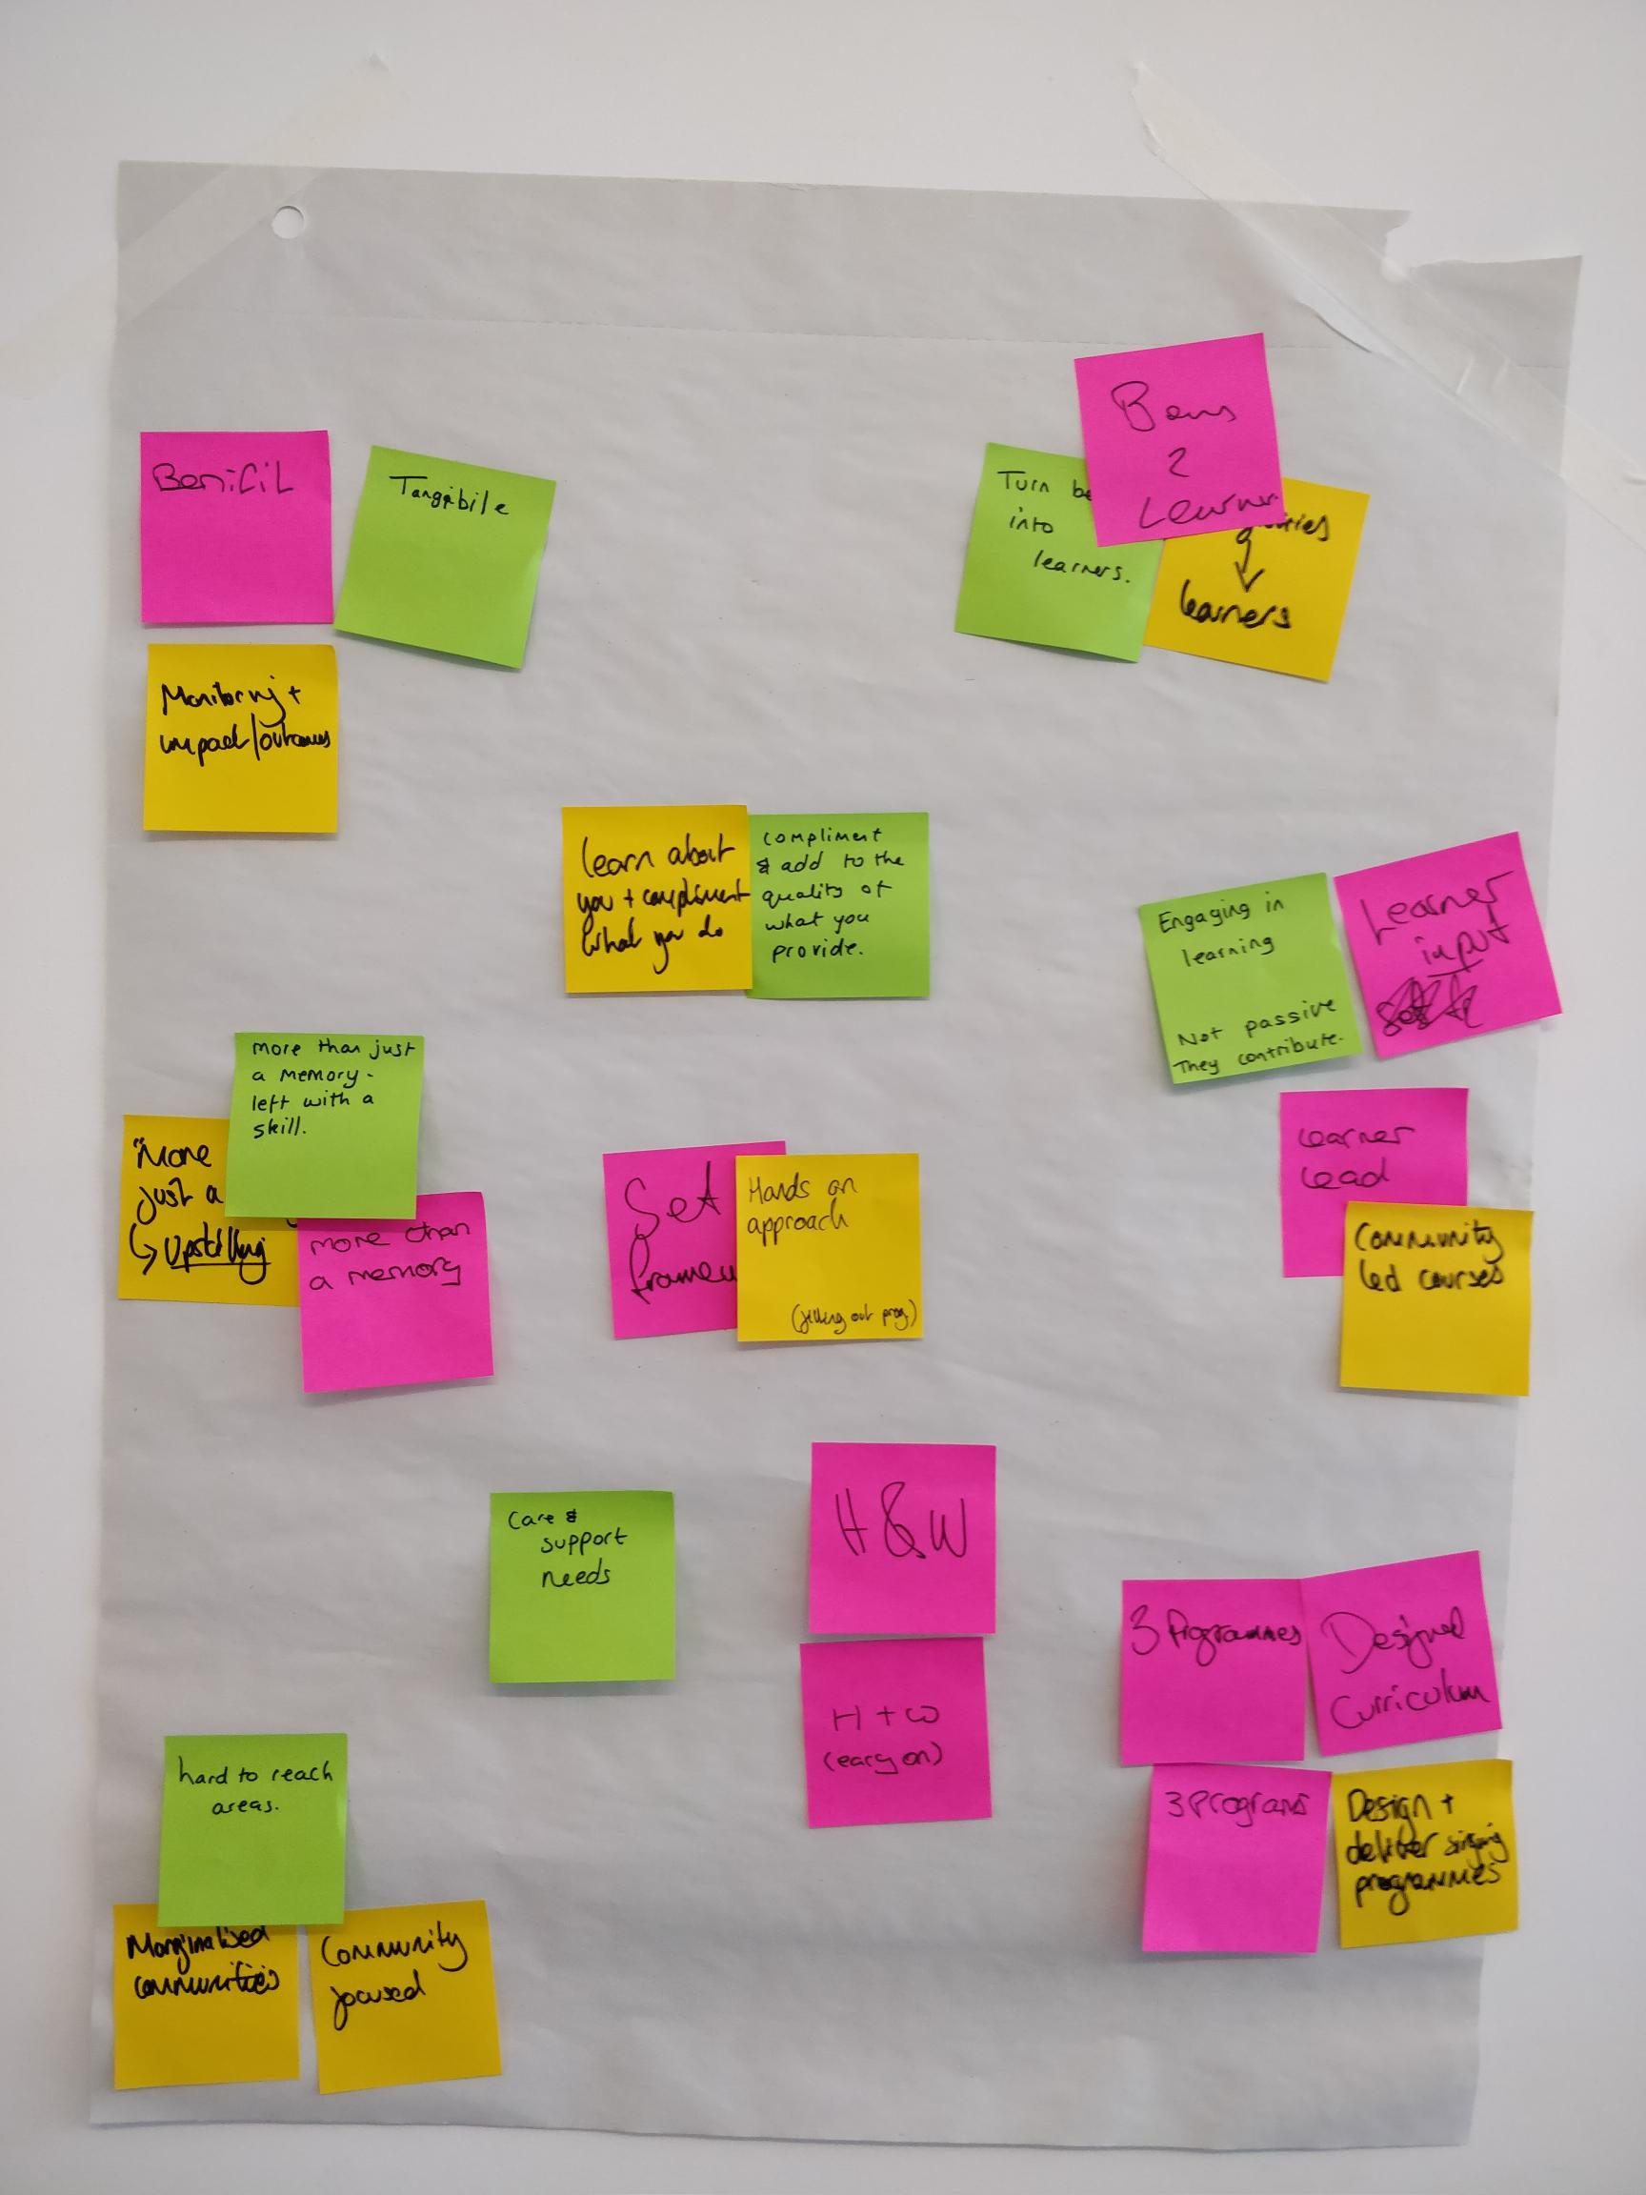
Step 3: Pitching
3 min, 1.5 min and 30 sec pitches from each person in the room with those listening noting down key pieces of dialogue.
Highlights:
  “more than just a memory”
  Community/learner led
  Health and wellbeing

Slide 5
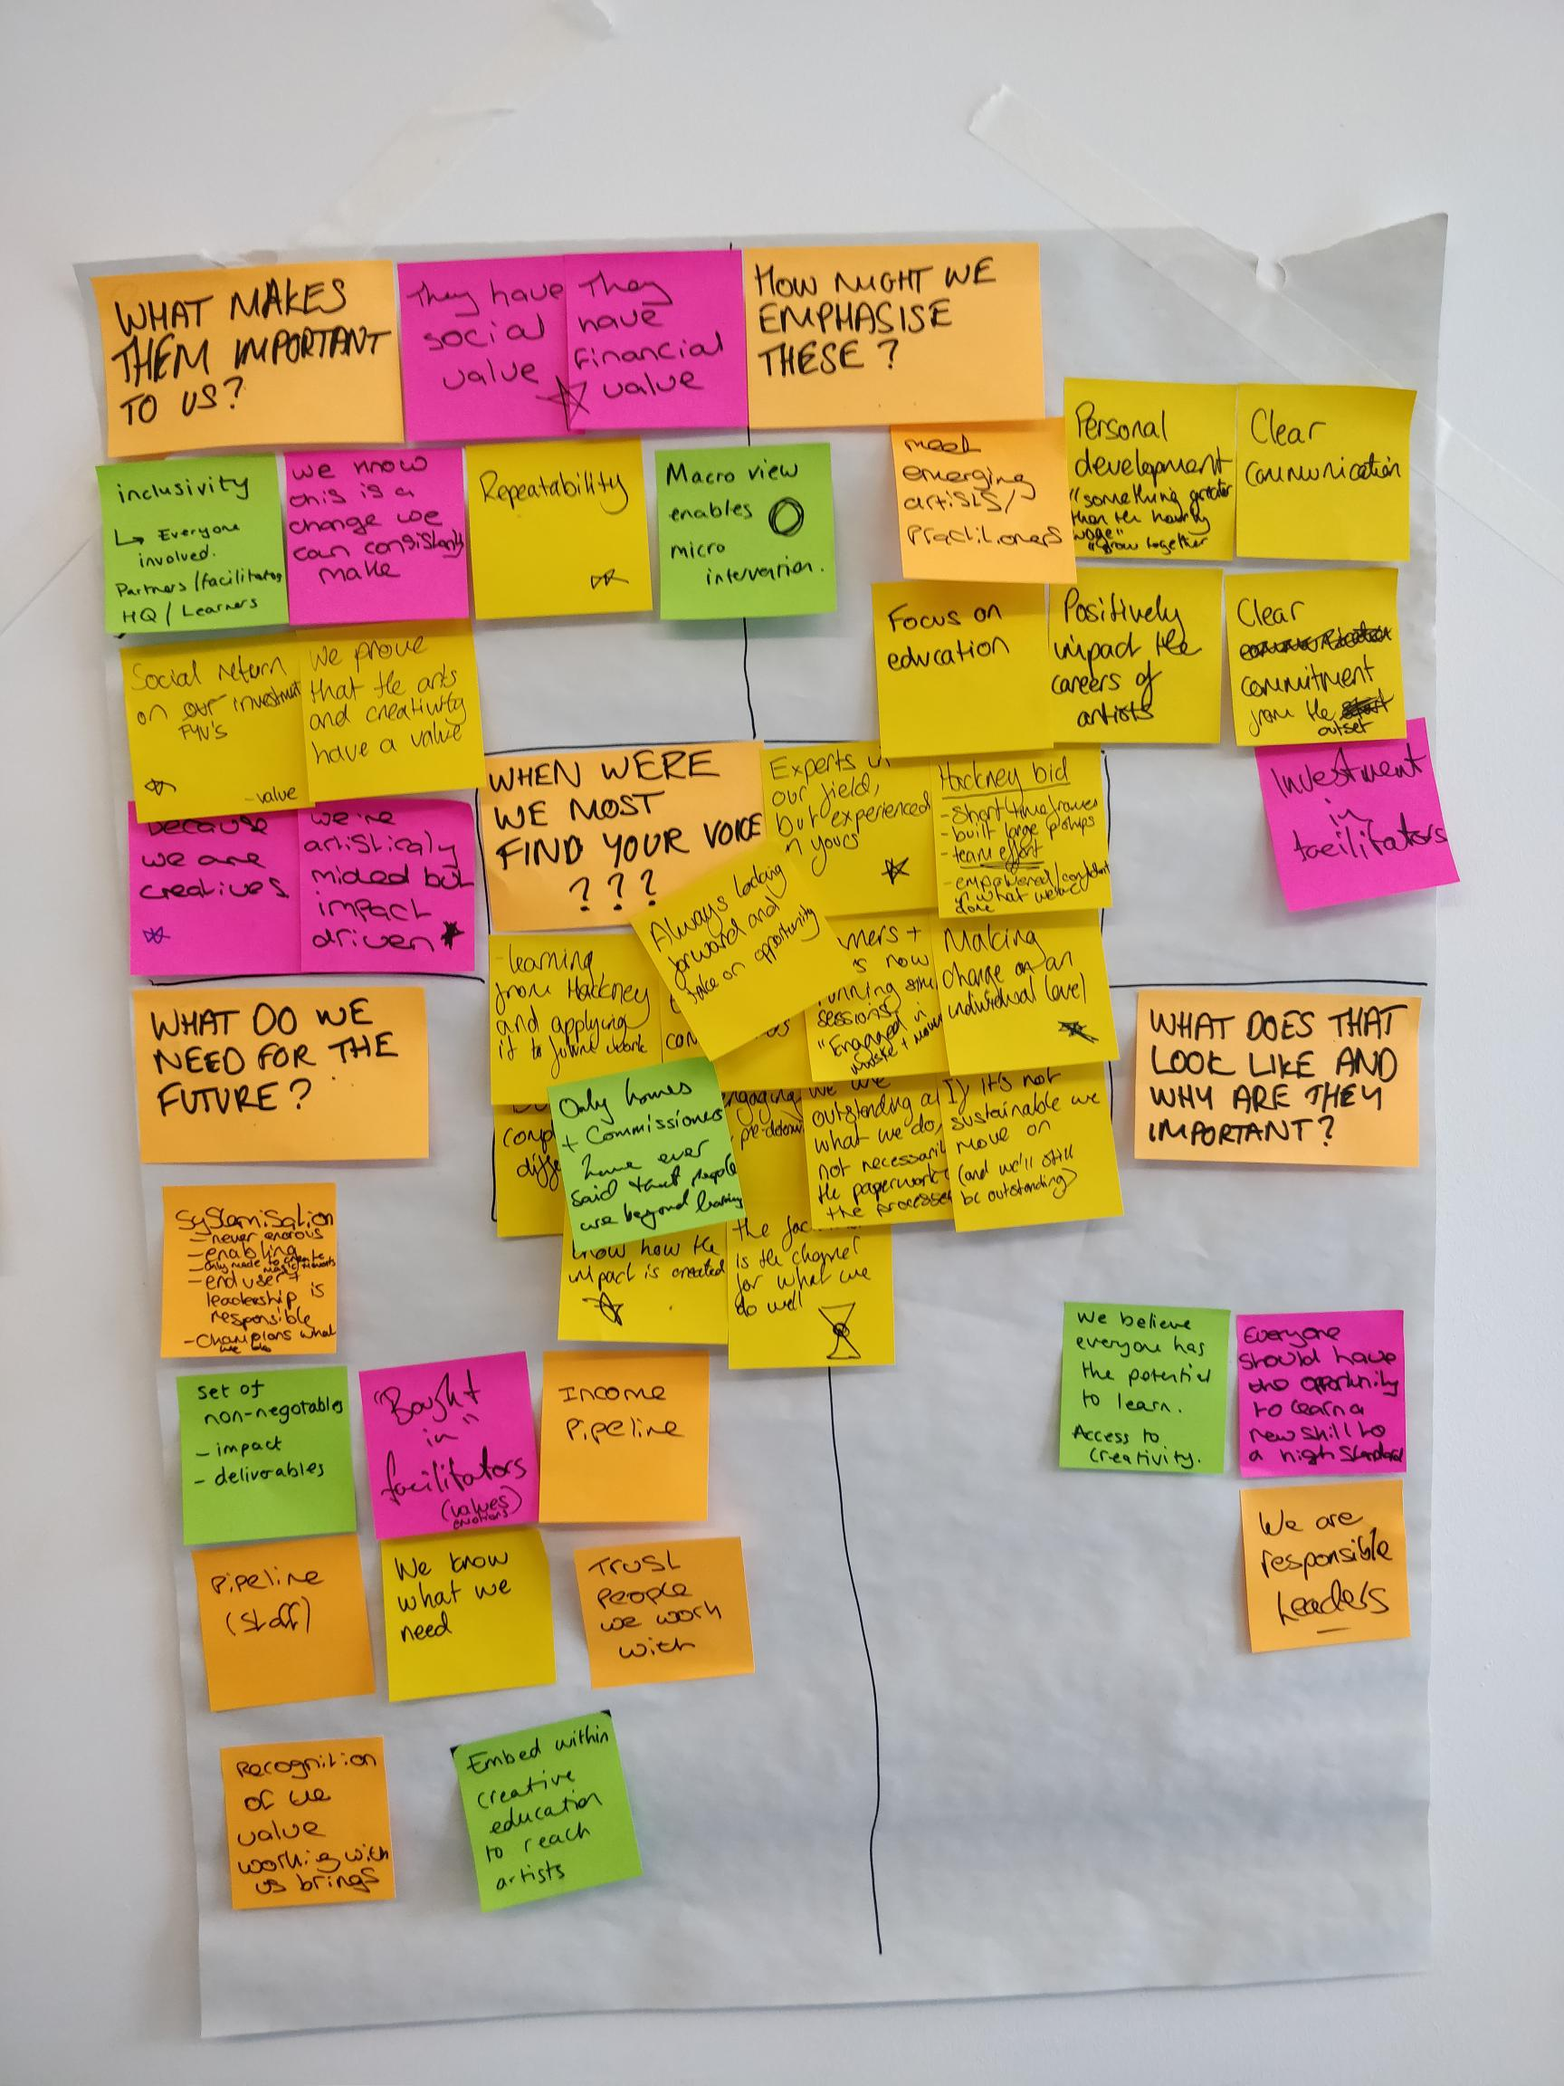
Step 4: When were we most Find Your Voice?
Focusing on this central question we explored examples of when we felt most “Find Your Voice”. Wrapped around this was 4 additional questions:
  What makes them important to us?
  How might we emphasise these?
  What does that look like and why are they important?
  What do we need for the future?
Highlights:
  “If it’s not sustainable we move on” (and we’ll still be outstanding)
  Everything must have a social and/or financial value
  Systemisation is important as long as it’s never onerous or holds back our leaders
  We are responsible leaders and trust the people we work with
  The facilitators are the channel we work through
  Clear communication and commitment is vital from the outset

Slide 6
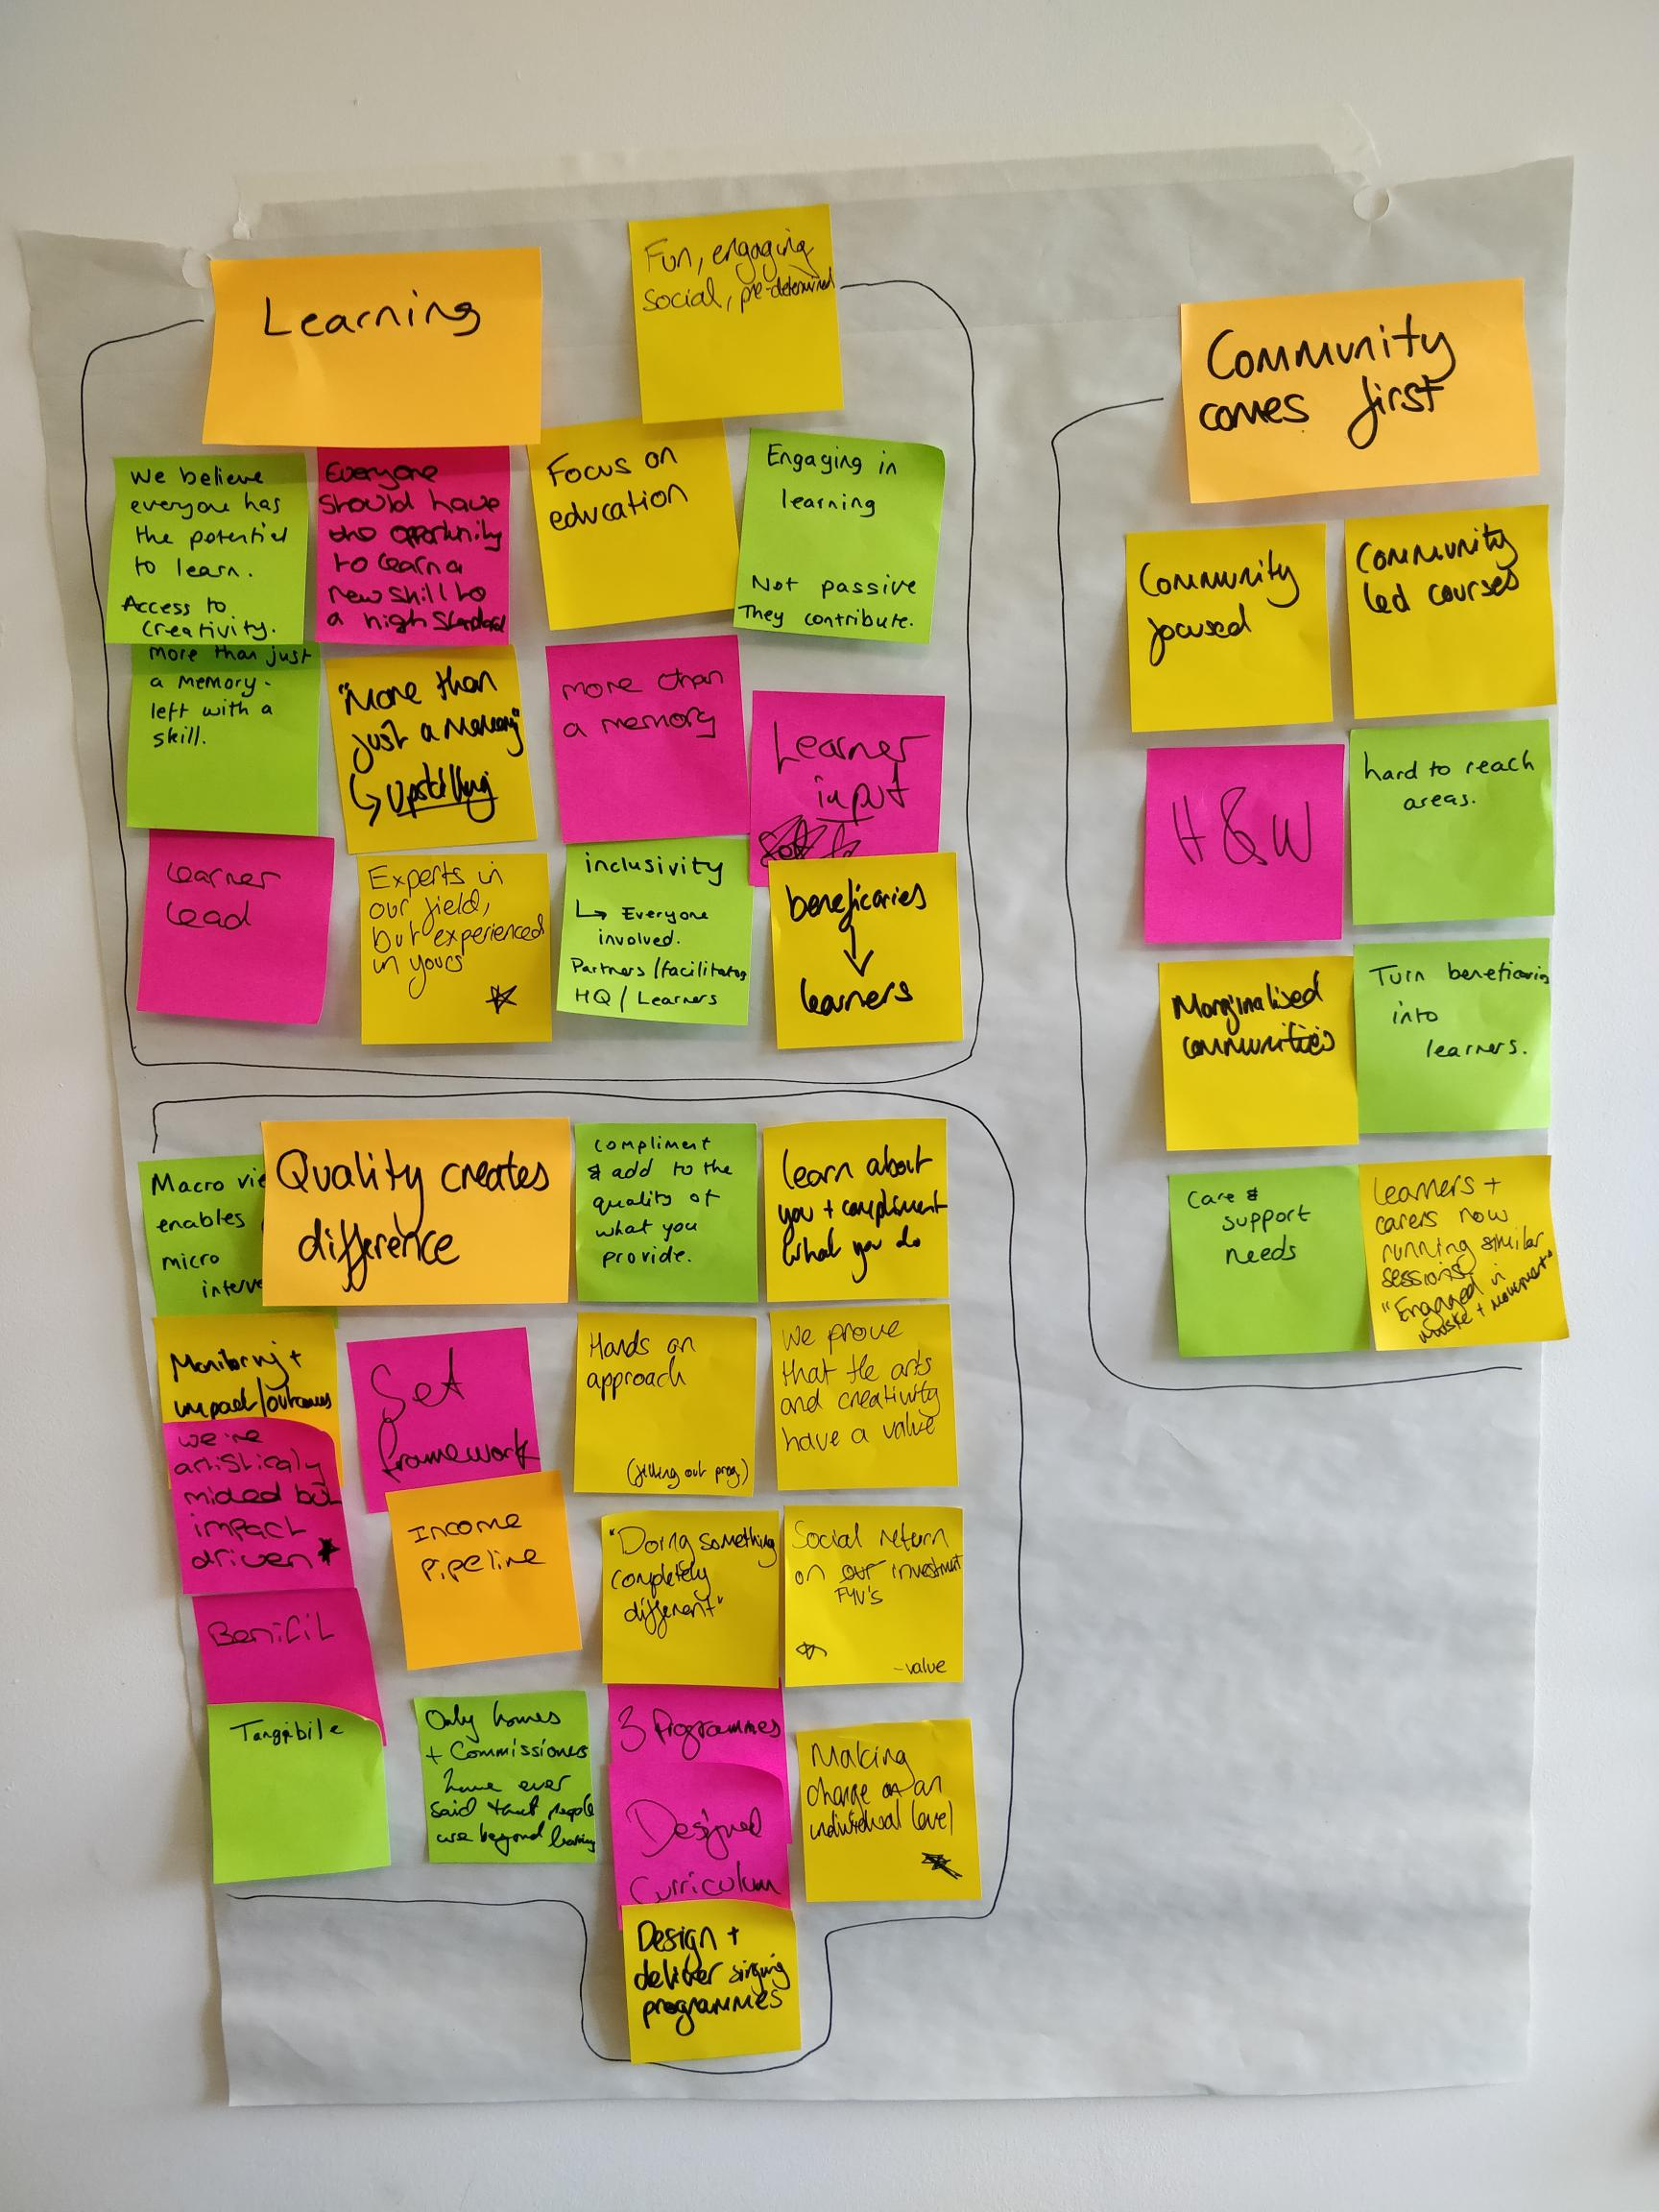
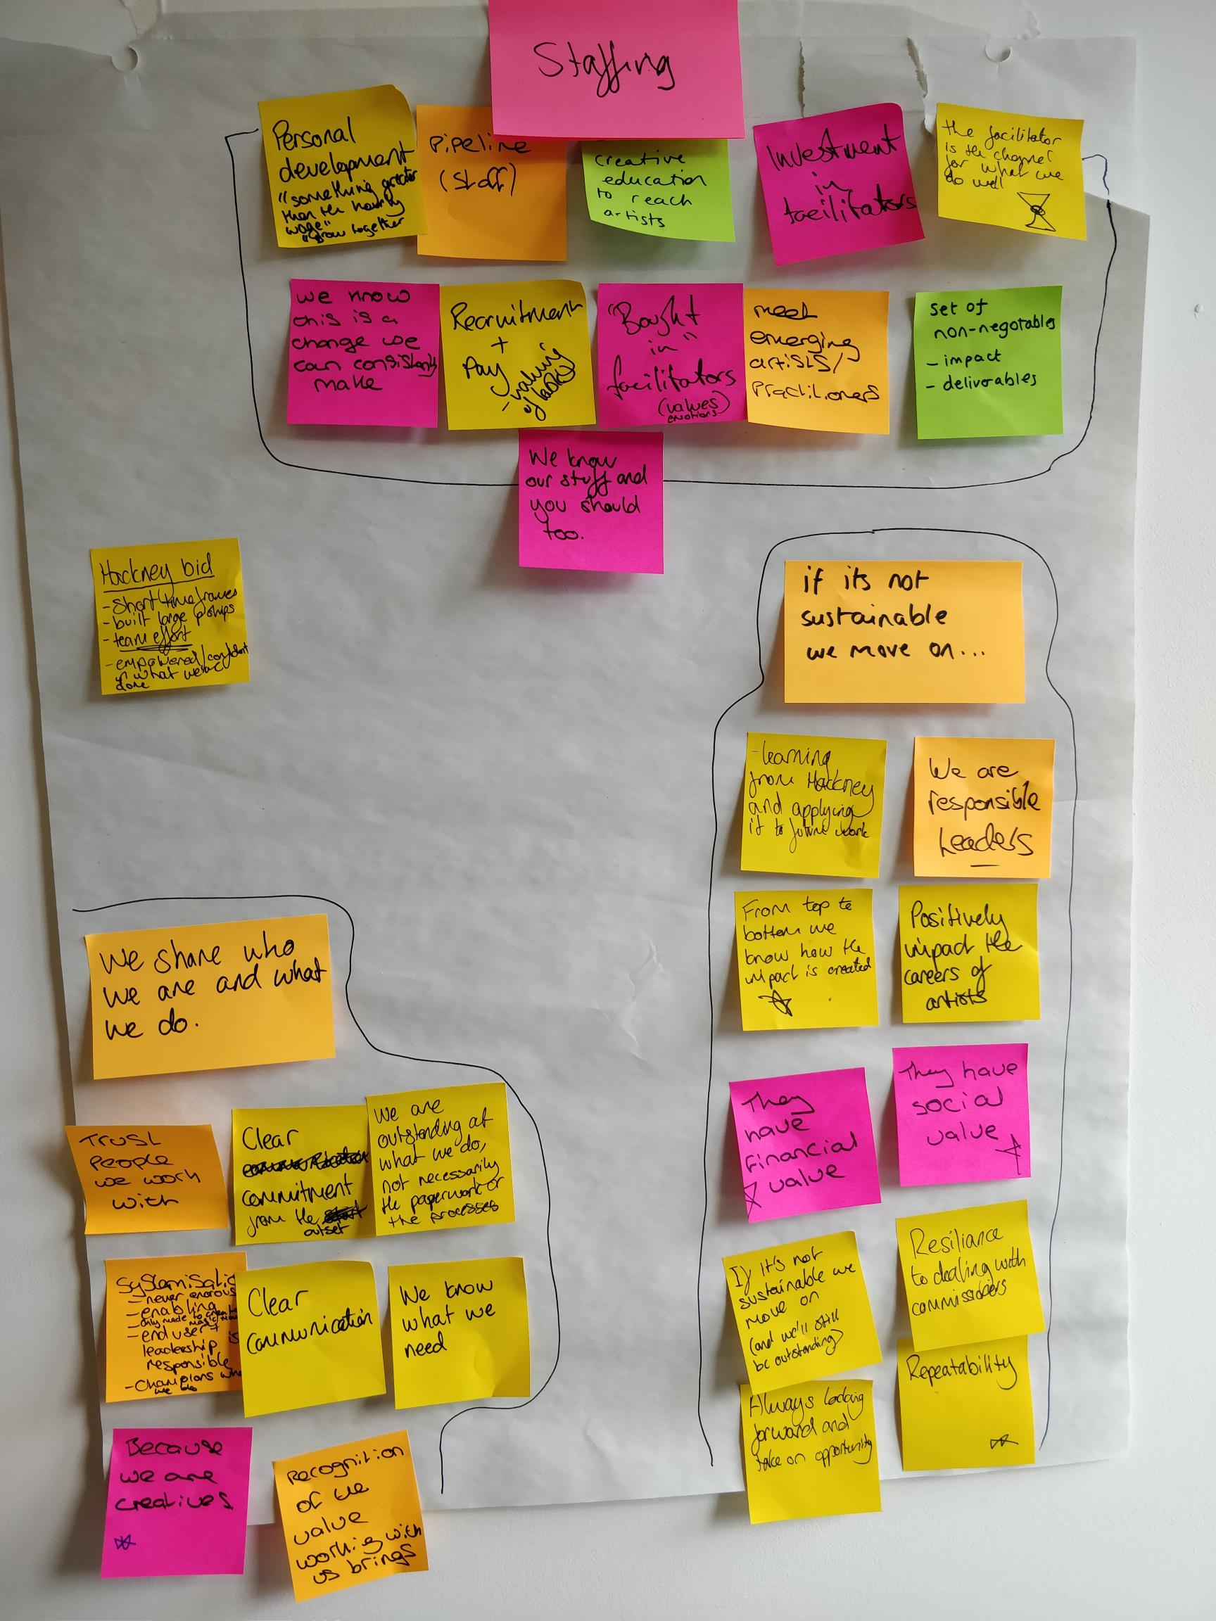
Step 5: Grouping together what we’ve just done
This was the first step to creating the values of the organisation, these received broad headings of:
Learning
Community Comes First
Quality creates difference
If it’s not sustainable we move on
We share who we are and what we do
“staffing”

Slide 7
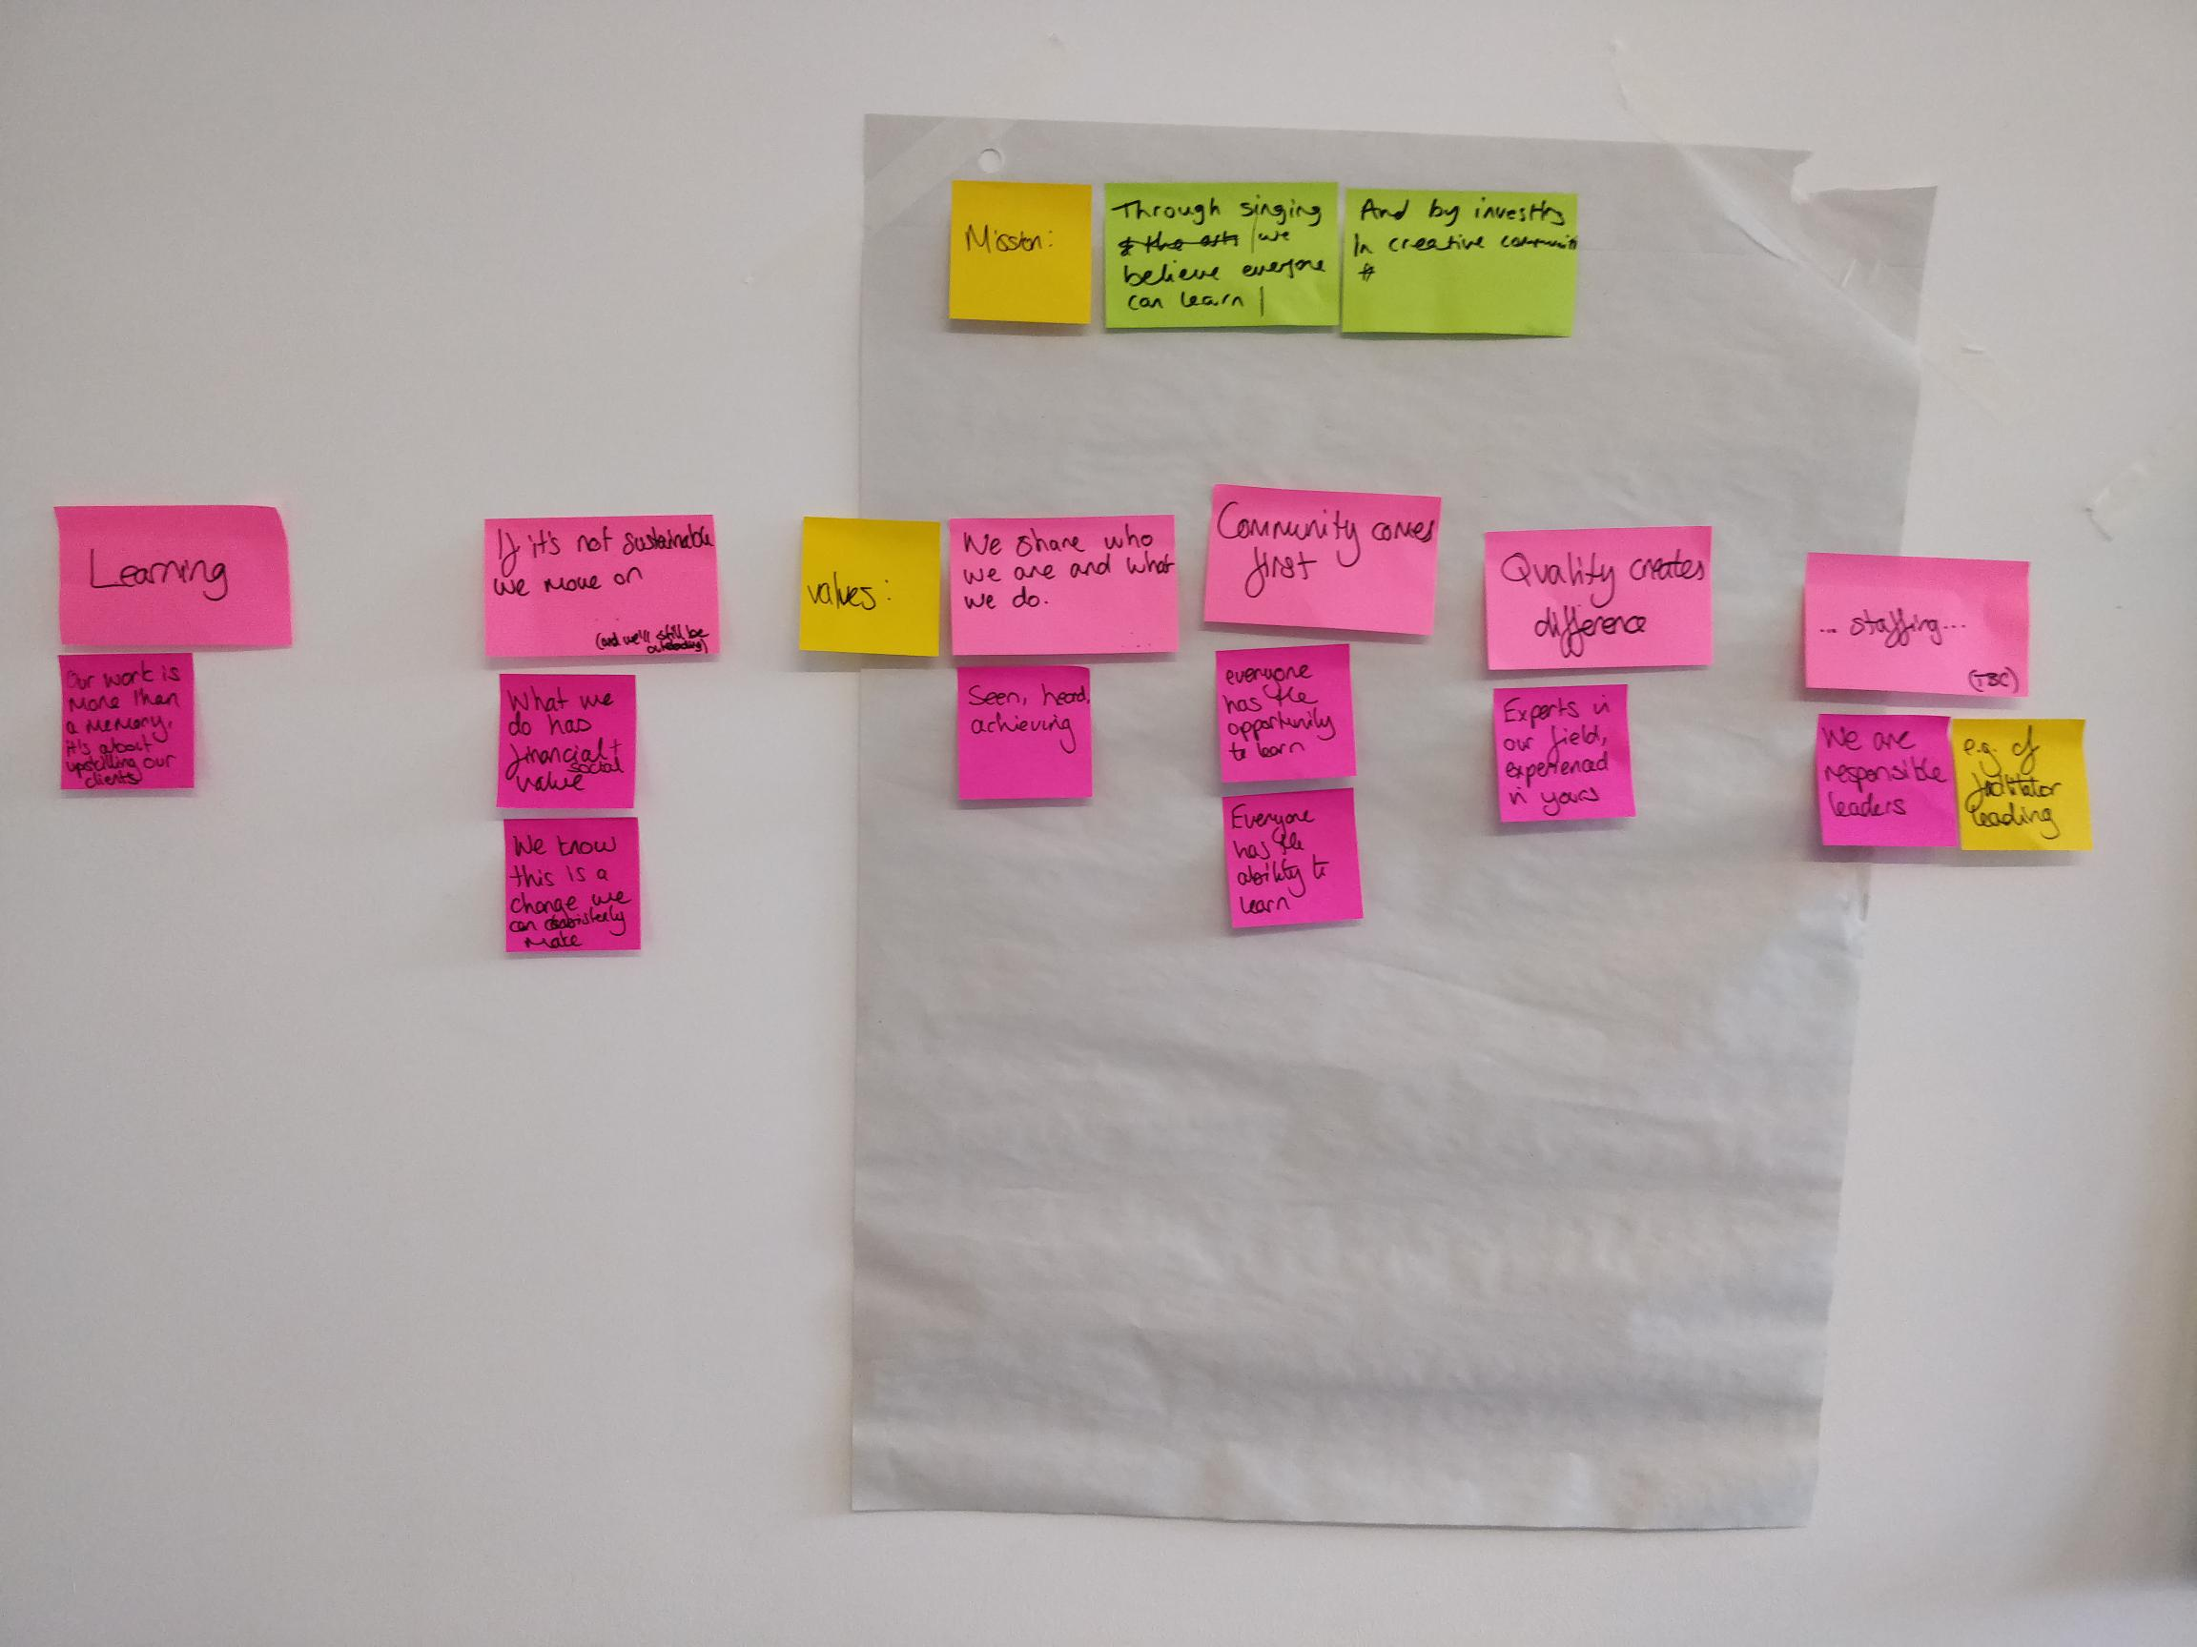
Step 6: Creating a mission statement

Slide 8
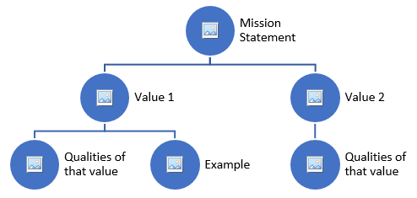
Step 7: Creating a Mission and Values Tree
Using the design to the right we now tried to draw together all the learning from the session. Underpinning the mission statement with a set of values that are supported by characteristics and examples of best practice (making them more robust, tangible and accountable)

Slide 9
Resources
Netflix’s values: https://www.slideshare.net/reed2001/culture-1798664/24-Were_a_team_not_a
https://toolbox.hyperisland.com/team-purpose-culture
http://www.designkit.org/methods#filter
https://toolbox.hyperisland.com/

